Slide 1
Cloud Logistics for First Responders
Service Overview
April 25th 2014

Slide 2
Introduction
Founded in late 2012
Solutions designed with First Responder organizations in mind
Resgrid's mission is to apply the latest technology to solve the mission critical needs of our customers, with updates and deployments weekly.
Over 500 departments using the system worldwide
Cloud based logistics system with private cloud and on premises options
Mobile applications for Responders, Apparatuses and IC’s

Slide 3
Executive Summary
Complete cloud logistics for first responder organizations
Concept
Zero installation and maintenance, low cost
Mobile and Web Based
Opportunity
Potential
Highly flexible solution adapts to every department

Slide 4
What Is Resgrid?
Resgrid is a cloud based logistics system for first responder organizations, allowing you to manage all aspects of your department in one place.
Resgrid
Personnel
Incidents
Stations
Units
Public
Reporting
Planning

Slide 5
The Opportunity
Resgrid provides an unique opportunity, to implement the latest technology, utilize the latest devices and extend your current infrastructure without a capital investment, large project or vendor lock in.
Low cost, no contract, yearly subscription with FREE options
Turn key instant on system
Open API to integrate with any existing system
Need a feature that Resgrid doesn’t have? Resgrid is updated weekly, your new feature could available in 14 days.

Slide 6
For Personnel
From Mobile Apps or the website personnel can:
Schedule staffing level changes (Available, Delayed, Unavailable, etc)
Receive Email, Text/SMS Messages, Push Notifications & Voice Calls for alerts & dispatches.
Track Certifications
Send broadcasts/messages
View all department/call information
View all call information
Attach notes & images to calls, view files attached to calls
Apps available on Apple App Store, Google Play
and Windows Phone Marketplace

Slide 7
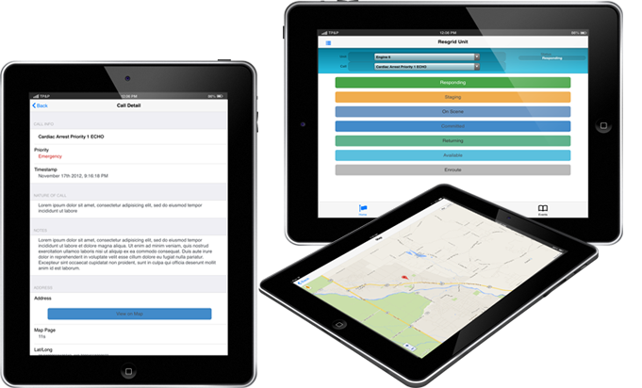
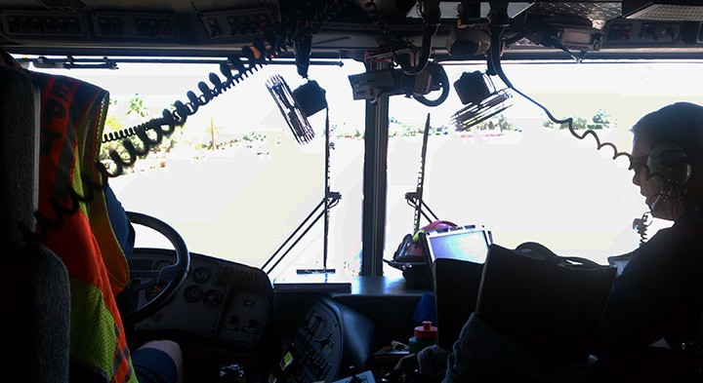
For Apparatuses
Mobile Apps allow Units to quickly and effortlessly update their status
Unit events are geo-tagged so they can be used for reporting
View call details, location on a map, take notes
Works offline, after syncing with Resgrid at the station.
Apps available on Apple App Store, Google Play
and Windows Phone Marketplace

Slide 8
For Departments
Complete Messaging, Polling and Callback system
Manage stations, shifts, roles and documentation for a department
Import calls from a CAD system or create them internally
Calendar's for departments and stations with shared notes and documents.
Meeting management and logging
Inventory tracking
Logging, Reporting and Mapping

Slide 9
Resgrid Benefits
Resgrid allows all your departments personnel to see all information easily
Status of all Personnel and Units in a Department
Personnel in other stations can see an overall status of personnel and units allowing you to utilize apparatuses and personnel better
Important Information
Relay reports, broadcasts, red flag warnings in a simple manner to all personnel
Bi-Direction Communication
Resgrid allows all your departments personnel and units to communicate without phone calls, radio traffic, SMS/Text messages or Email.
Keeps contact, call and email lists small and gives all personnel bi-directional contact without having to share information

Slide 10
Value Proposition
Can be a stand alone system or integrate with other systems, i.e. CAD
Extend your existing CAD/Dispatch systems with the latest technology
Disseminate information to loosely connected personnel easily
Multiple communication paths (Email, Text/SMS, Push and Voice)
Free mobile applications designed for specific roles
Easy single point of control for managing all entities (personnel, units, etc)
Cloud based; no touch installation, no maintenance, weekly upgrades

Slide 11
Call to Action
Sign up for FREE at http://resgrid.com
Email your questions, issues or feature requests to team@resgrid.com

Slide 12
http://resgrid.com
3108 Silver Sage Dr.
Carson City, NV 89701
USA
1-888-570-4953
team@resgrid.com

